Slide 1
DA 507 modeling and optimization
Lecture 3
Linear & Integer Programming: Solution Methods
Güvenç Şahin
Birol Yüceoğlu

Slide 2
Outline
Linear programming with two variables
  Graphical solution approach
Linear programming with more than two variables
  Insights from the graphical solution approach that can be generalized to higher dimensions
  Basic feasible solutions of linear programs
  Main idea and the mechanics of the simplex algorithm
Duality and economic interpretations
  Basics of sensitivity analysis
Integer programming
  Branch-and-bound

Slide 3
The carpenter’s problem
A linear programming problem formulation
A carpenter tries to solve a weekly production planning problem to maximize profit. He solely makes tables and chairs, and sells all tables and chairs at a market place.
Both chairs and tables require the same type of raw material. The raw material availability is only 50 units per week.
  one chair requires 1 unit of the raw material;
  one table requires 2 units of the raw material.
The carpenter can work at most 40 hours every week. It takes 2 hours to make a chair while it takes only an hour to make a table.
The cost of a chair is 100 TL and it sells for 120 TL; the cost of a table is 130 TL and it sells for 145 TL.

Slide 4
The carpenter’s problem
A linear programming problem formulation
Problem formulation
Maximize z = 20x₁ + 15x₂
subject to 2 x₁ + x₂ ≤ 40
x₁ + 2 x₂ ≤ 50
x₁ ≥ 0, x₂ ≥ 0

Slide 5
The carpenter’s problem
A linear programming problem formulation
Consider the following labor constraint and let us discuss the following points
  2 x₁ + x₂ ≤ 40
How many chairs (x1) can you produce if you do not produce any tables (x2)?
  x2 = 0 and x1 = 20
How many tables can you produce if you do not produce any chairs?
  x1 = 0 and x2 = 40
What happens if you decide to produce 10 chairs? How many tables can we produce?
  x1 = 10 x2 = 40 – 2 * 10 = 20

Slide 7
The carpenter’s problem
A linear programming problem formulation
Now let us do the same thing for the raw material constraint
  x1 + 2 x2 <= 50
How many chairs (x1) can you produce if you do not produce any tables (x2)?
  x2 = 0 and x1 = 50
How many tables can you produce if you do not produce any chairs?
  x1 = 0 and x2 = 25
What happens if you decide to produce 20 chairs? How many tables can we produce?
  x1 = 20 and x2 = (50 – 20) / 2 = 15

Slide 9
Putting it together

Slide 10
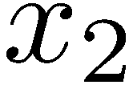
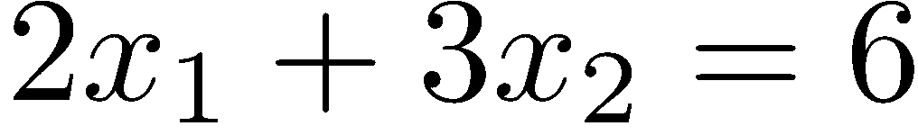
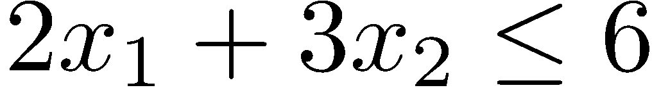
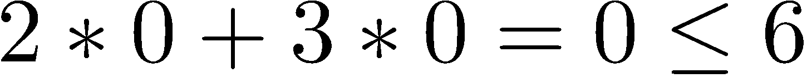
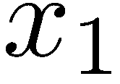
Graphical Solution to a 2-Variable LP
Any LP with only two variables can be solved graphically.
The first step is to identify the feasible region by determining the intersection of the constraints that define the feasible region.
For instance, to identify the set of points in the graph satisfying the equation

Slide 11
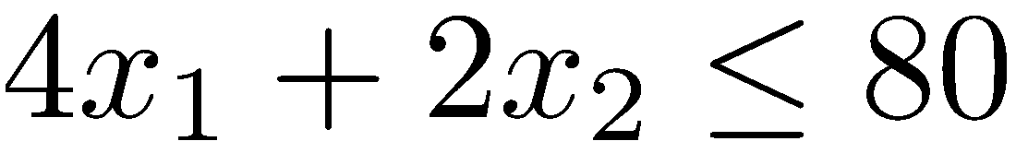
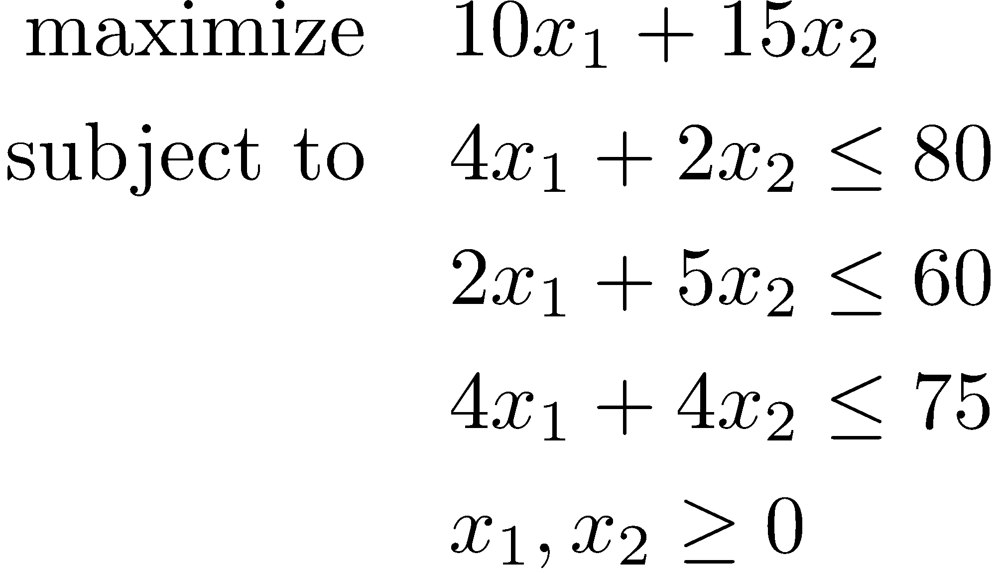
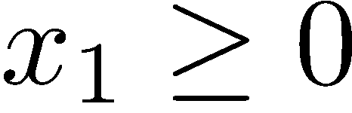
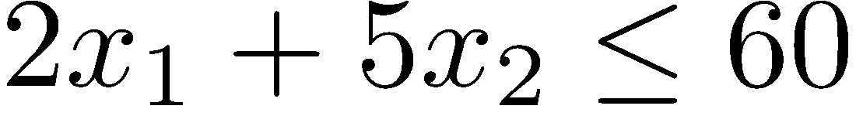
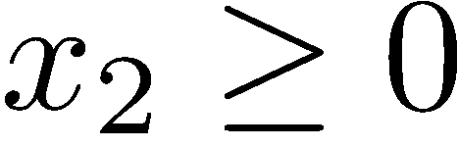
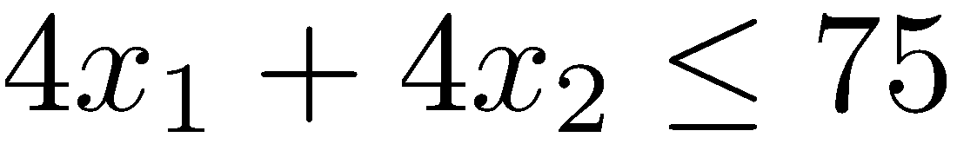
Model of Factory A
40
30
20
10
Feasible region
10
20
30

Slide 12
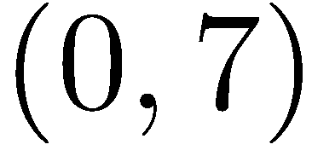
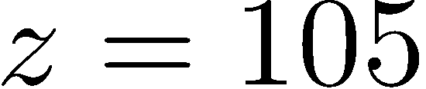
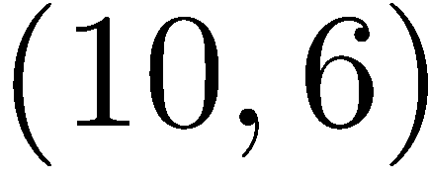
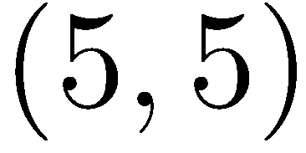
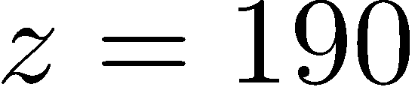
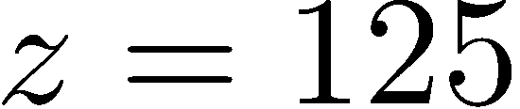
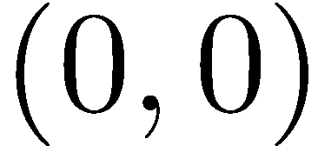
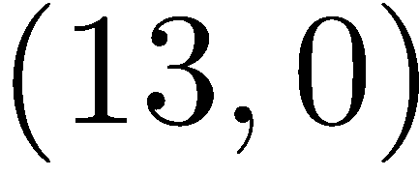

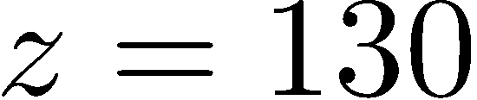
Model of Factory A
40
30
This is all nice and well. But how do we maximize the objective?
20
10
10
20
30

Slide 13
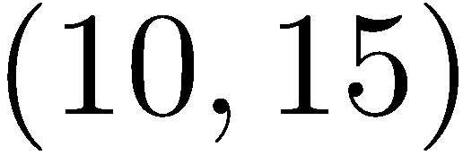
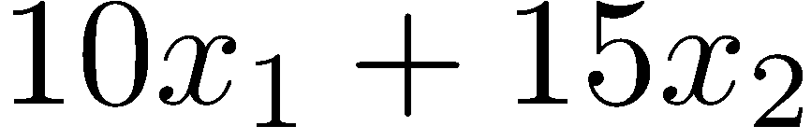
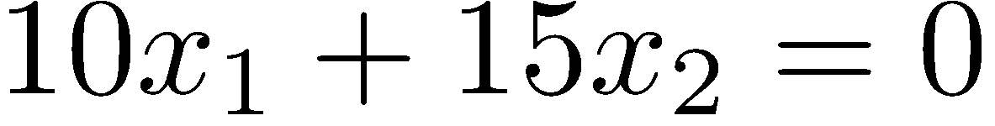
Model of Factory A
40
30
What is the red arrow?
  The vector (10, 15).
  The gradient of the objective
20
10
10
20
30

Slide 14
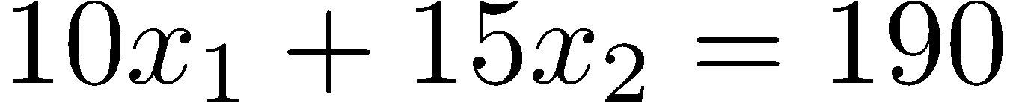
Model of Factory A
40
30
What is the key observation?
20
Move in a direction that makes an acute angle with the gradient in order to increase the value of the objective function!
10
10
20
30

Slide 15
Gradient
The gradient is a generalization of the usual concept of derivative of a function in one dimension to a function in several dimensions.
The gradient points in the direction of the greatest rate of increase of the function.
For a linear function, the gradient is identical at all points in the feasible region.
These facts suggest the solution procedure on the next slide.

Slide 16
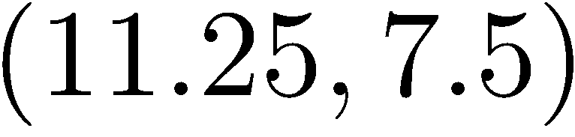
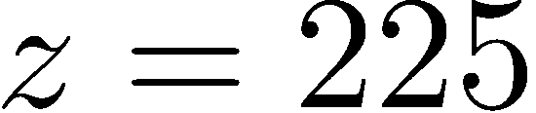
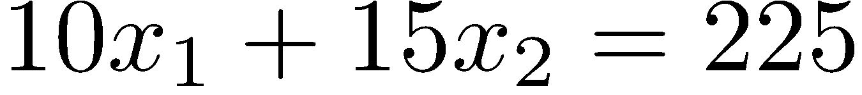
Model of Factory A
40
30
Pick a starting solution.
Move as much as possible in the direction of the gradient.
The final point where an objective contour touches the feasible region is optimal.
Unfortunately, this approach is hardly practical with 3 variables, and impossible to implement with more variables.
20
10
10
20
30

Slide 17
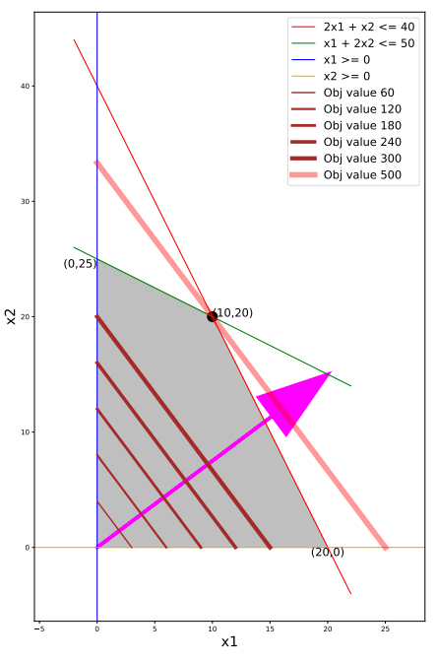
Back to the Carpenter
How much profit do
we make if we produce
  3 chairs only?
  4 tables only?
  6 chairs only?
  8 tables only?
What is the objective
function value for the
optimal solution?

Slide 18
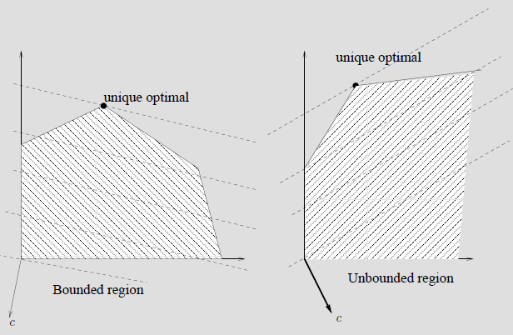
Possible outcomes of an LP
Minimization problems
Unique finite optimal solution.
If the optimal solution is unique, then it occurs at an extreme (or corner) point of the feasible region.

Slide 19
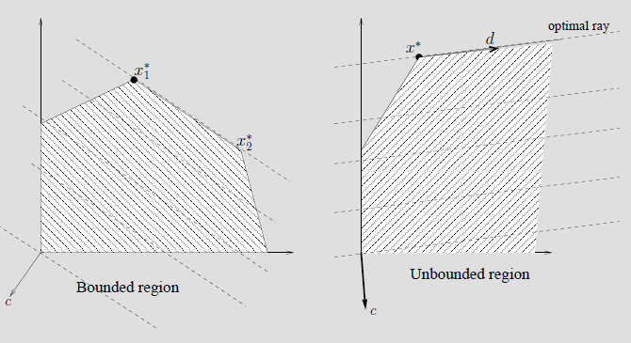
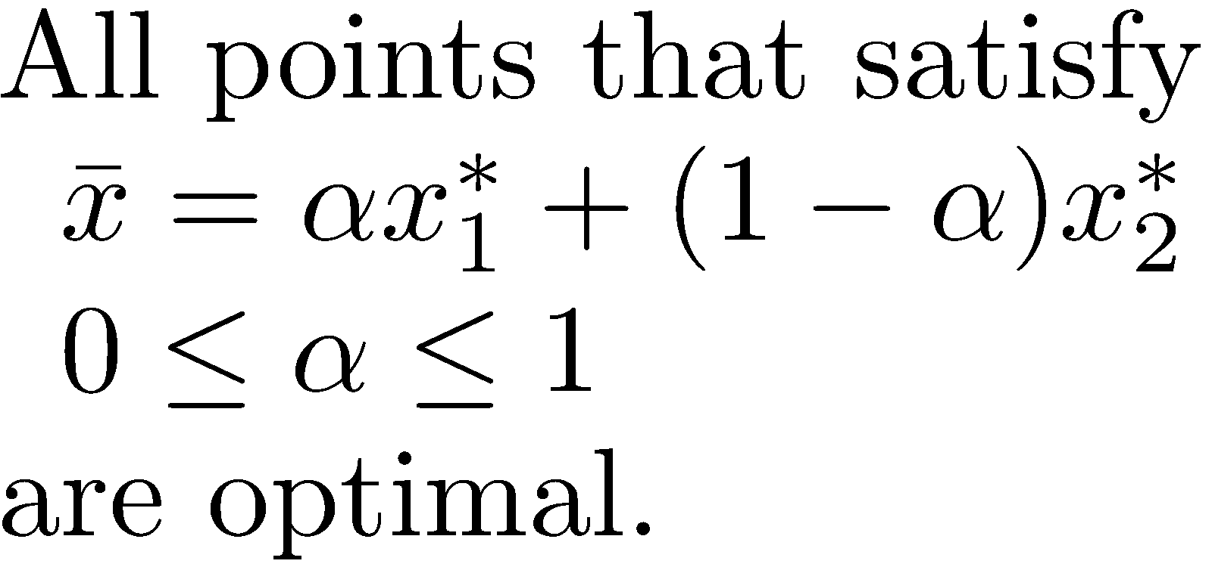
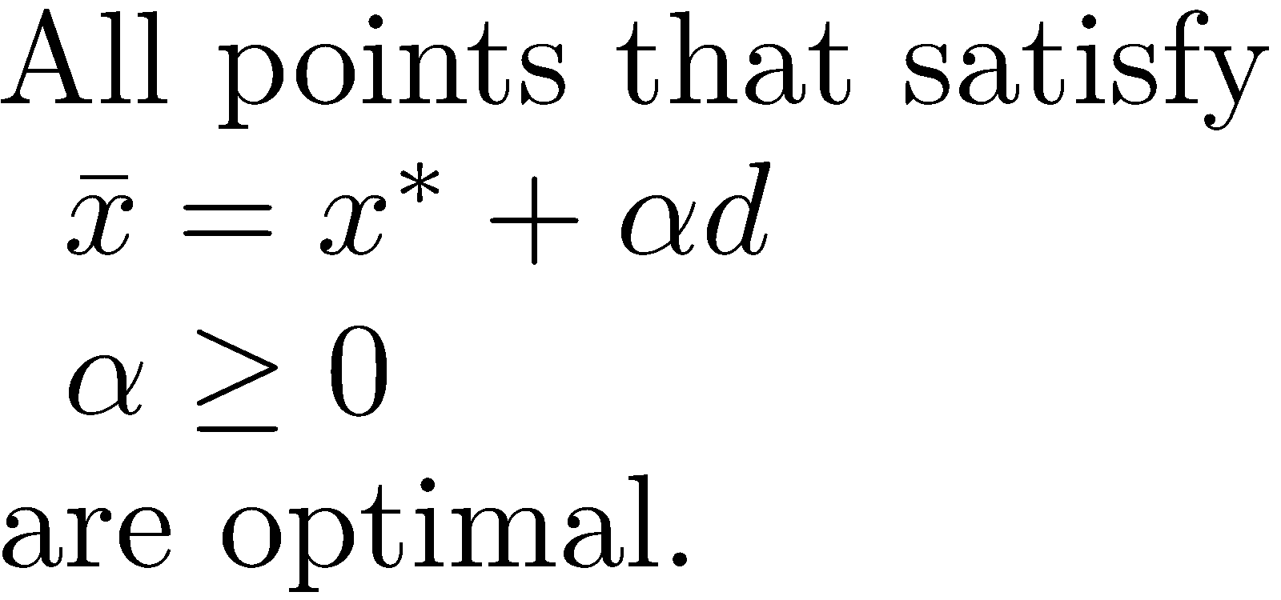
Possible outcomes of an LP
Minimization problems
Alternate finite optimal solutions.
In this case, there are infinitely many optimal solutions.

Slide 20
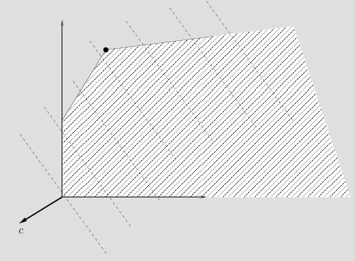
Possible outcomes of an LP
Minimization problem
Unbounded solution.
We can identify feasible solutions with arbitrarily small objective values.

Slide 21
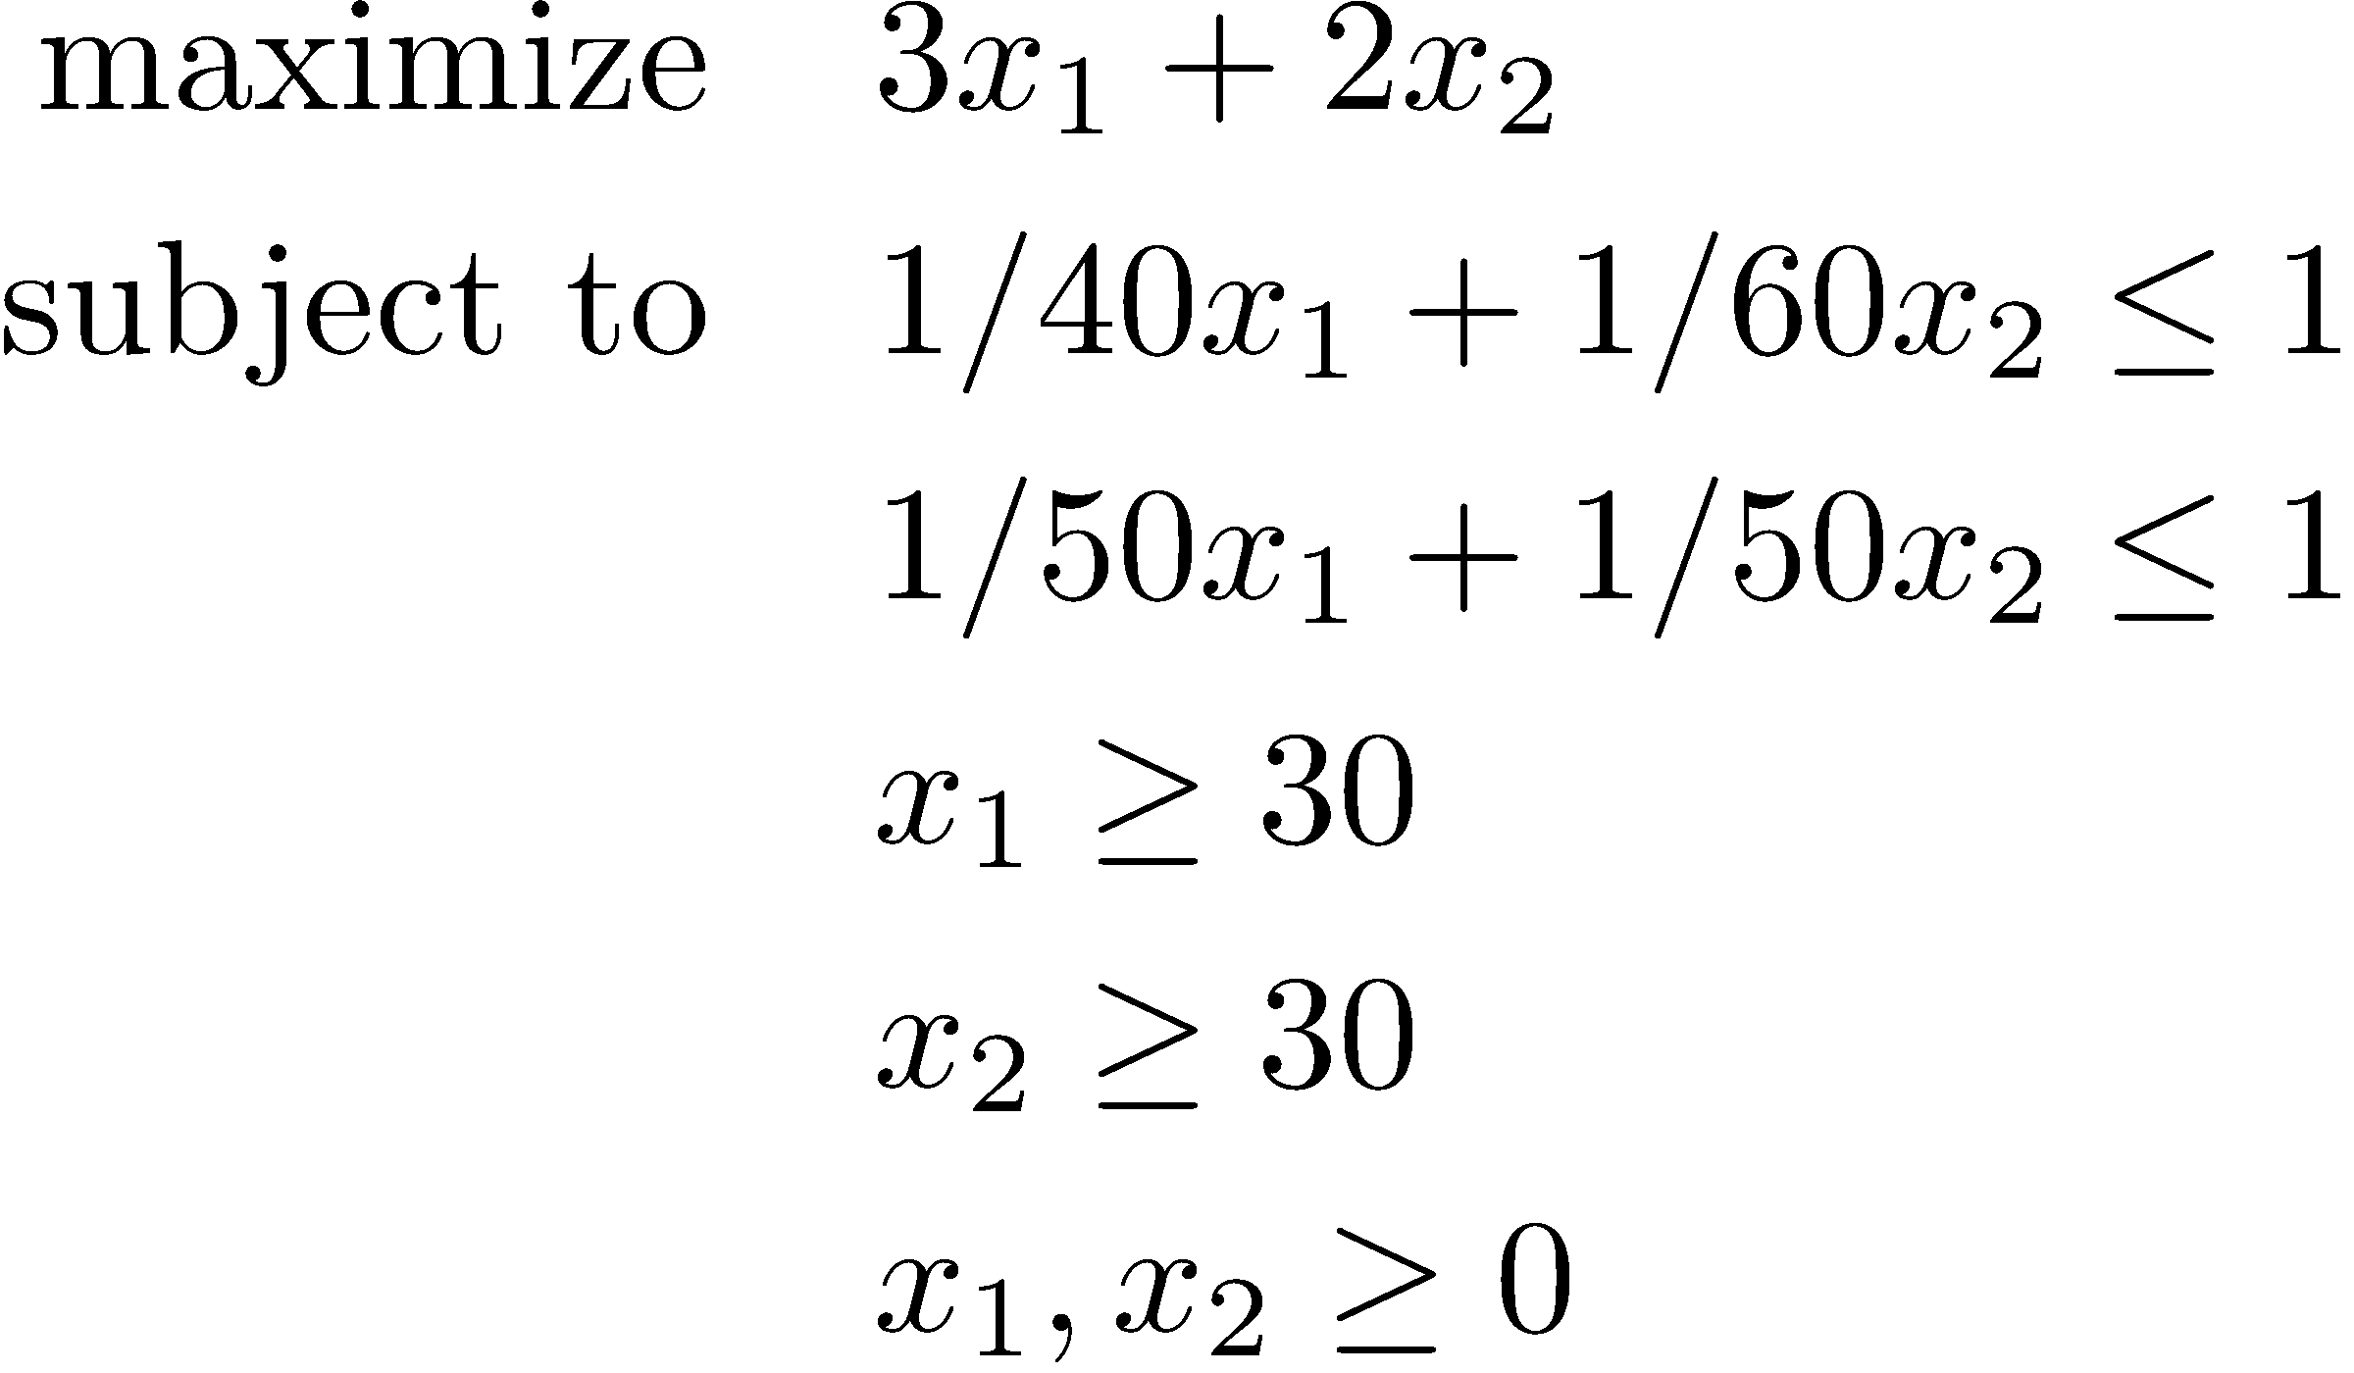
Possible outcomes of an LP
Infeasible model.
The system of equations defining the feasible region is inconsistent.

Slide 22
Outcomes of an LP – insights from the graphical solution
Thus, an LP model has three possible outcomes:
  The model is infeasible.
  The model is unbounded.
  The model has an optimal solution. If the model has an optimal solution, then there exists an extreme point optimal solution.
For a given instance, the objective of any linear programming algorithm is to determine the appropriate certificate for one of these cases.

Slide 23
Outcomes of an LP – insights from the graphical solution
If an LP model model has an optimal solution, then there exists an extreme point optimal solution.
  How can we characterize extreme points?
  How can we turn this into an algorithm?
Beware that this discussion is incomplete at some points for the ease of understanding

Slide 24
Linear programming algorithms
Simplex algorithm (Dantzig, 1947)
  Poor theoretical, excellent empirical performance.
Ellipsoid method (Khachiyan,1979)
  Theoretically superior to the simplex algorithm, poor practical performance.
Interior point algorithms (Karmarkar, 1984)
Simplex and interior point algorithms are used in practice.
  Empirically, the performance of either algorithm depends on the specific problem instance.

Slide 25
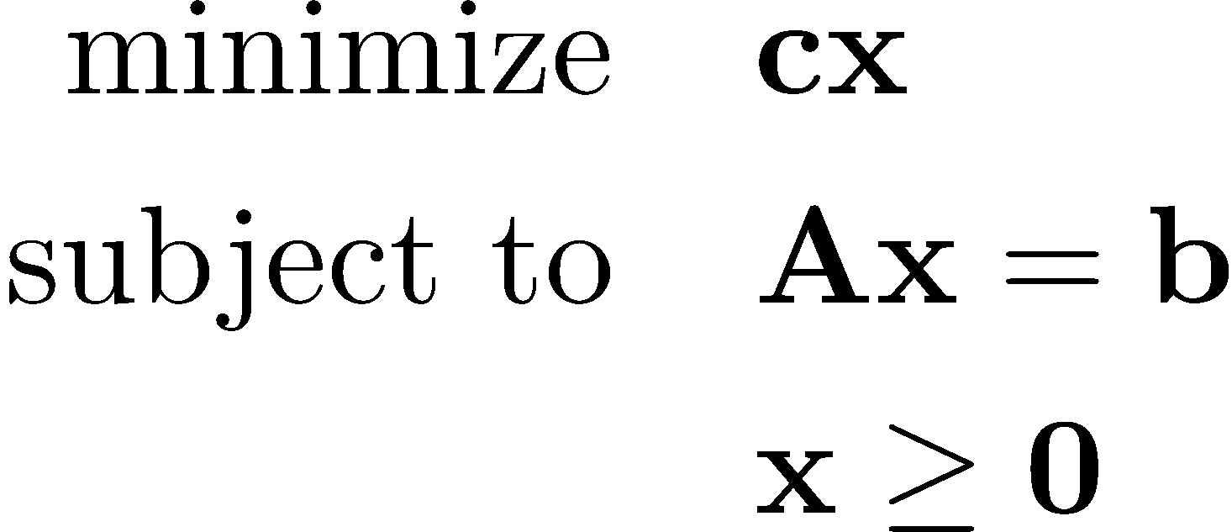
Different representations of an LP
Before discussing the main idea of the simplex algorithm we digress briefly to illustrate the different generic forms for an LP. This will help and improve our understanding of the simplex method.
An LP is in standard form if it is written as
Any LP can be converted to standard form

Slide 26
Standard form
3 conditions are required for standard form:
  Non-negativity constraints for all variables.
  All remaining constraints are expressed as equality constraints.
  The right hand side vector, b, is non-negative.
We prefer to have a minimization problem (even though it is not required for the model to be in standard form)

Slide 27
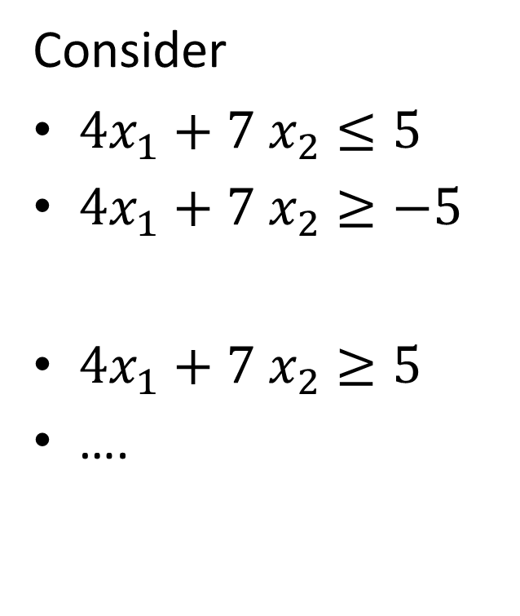
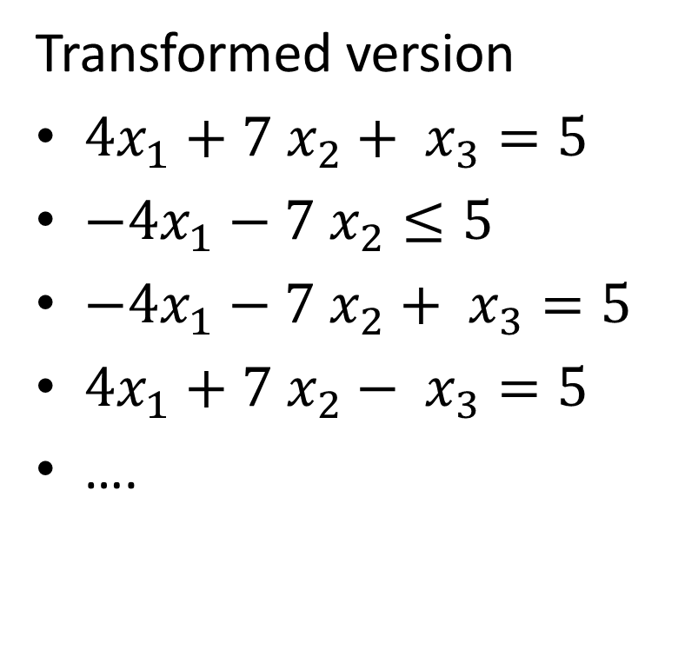
Standard form
Consider
$4x_{1}+7 x_{2}≤5$
$4x_{1}+7 x_{2}≥−5$
$4x_{1}+7 x_{2}≥5$
….
Transformed version
$4x_{1}+7 x_{2}+ x_{3}=5$
$−4x_{1}−7 x_{2}≤5$
$−4x_{1}−7 x_{2}+ x_{3}=5$
$4x_{1}+7 x_{2}− x_{3}=5$
….
Slack
Surplus

Slide 28
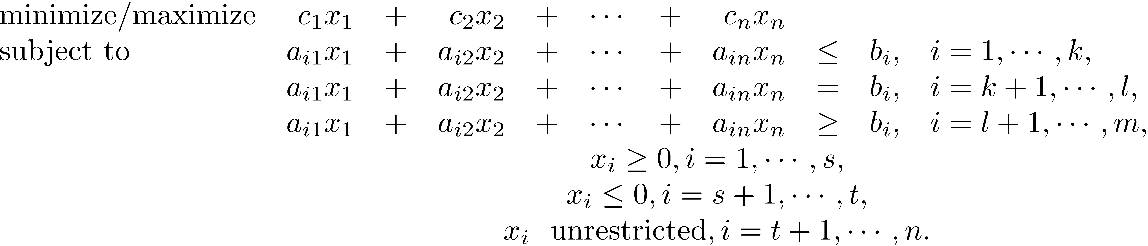
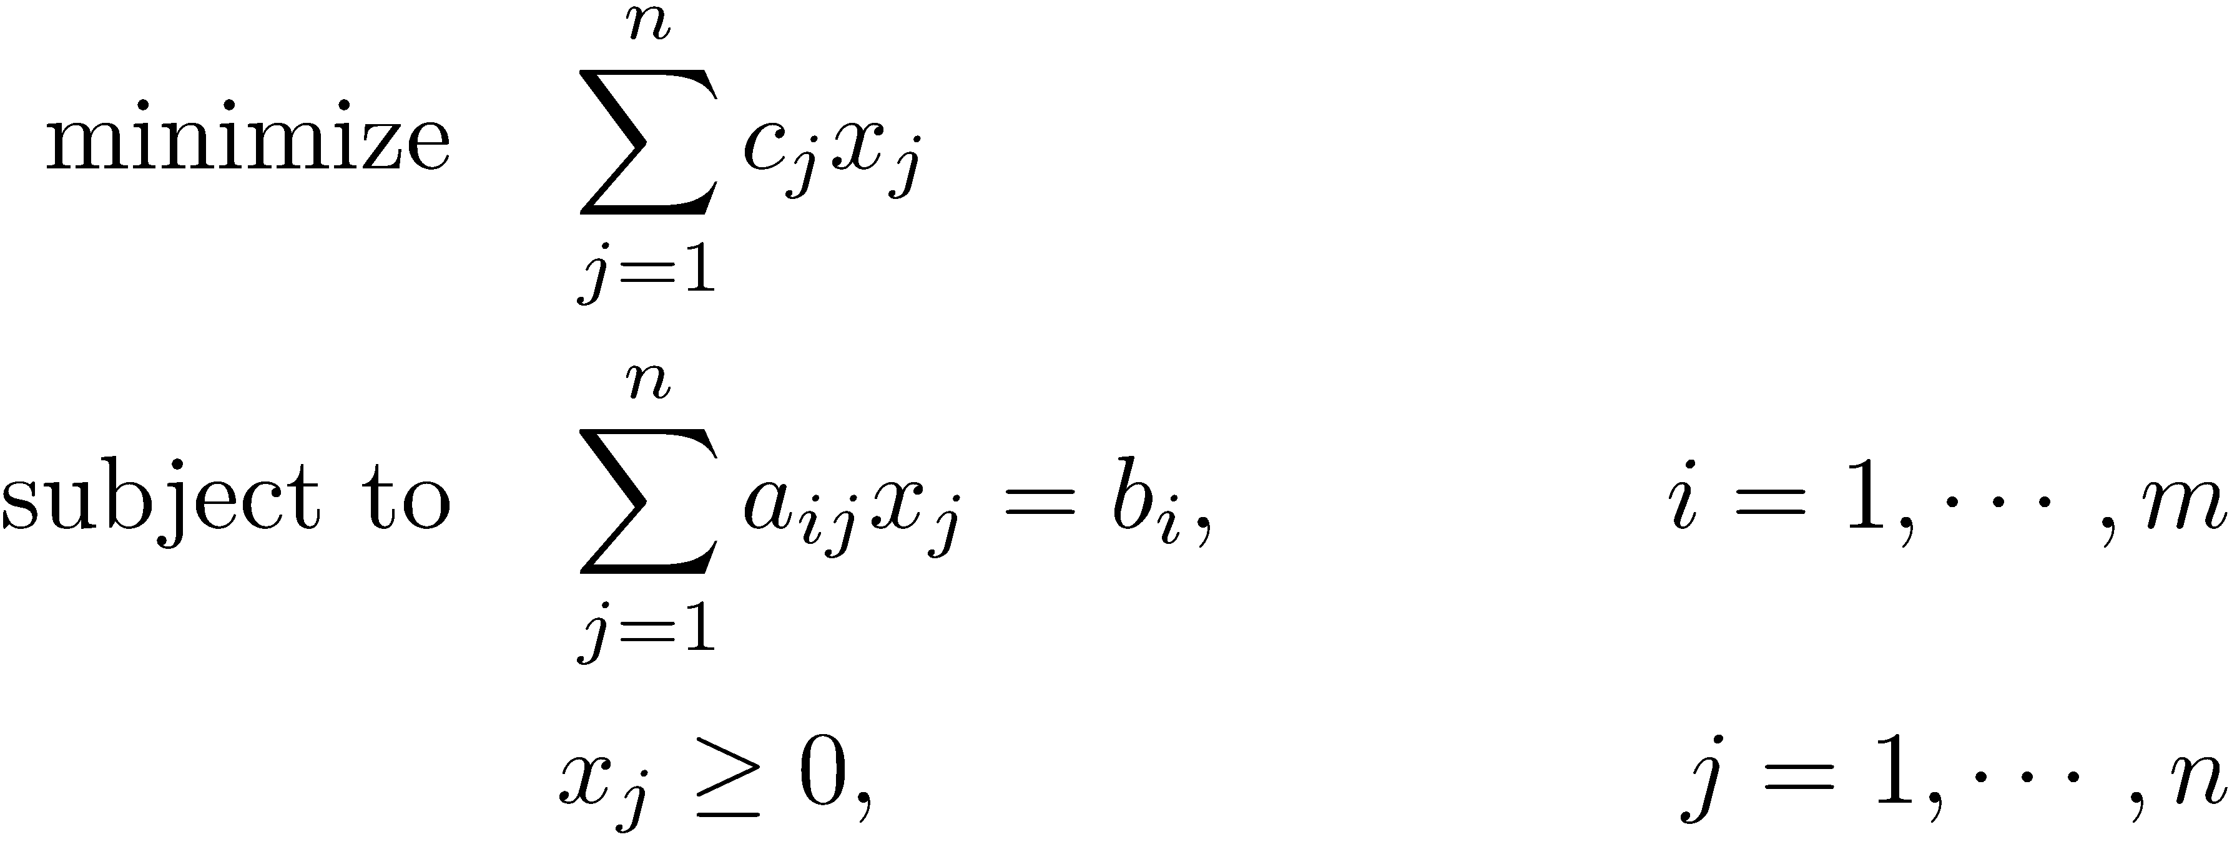
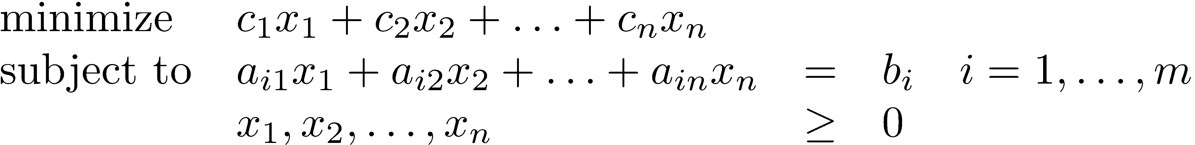
Different representations of an LP
We know how to manipulate the sense of the objective function, the inequality constraints, and the non-positive / unrestricted variables.

Slide 29
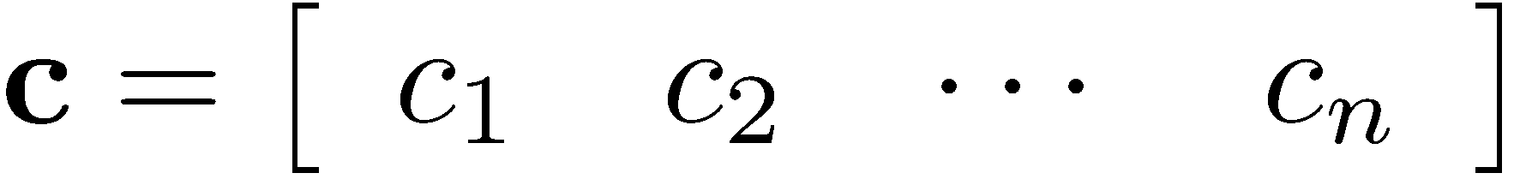
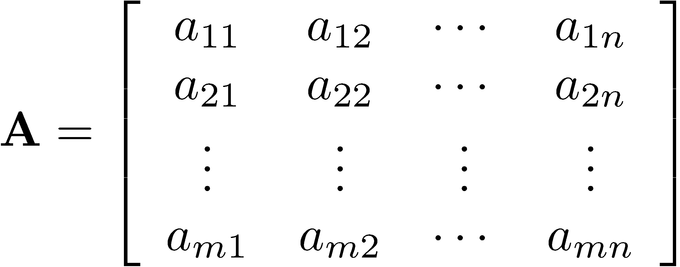
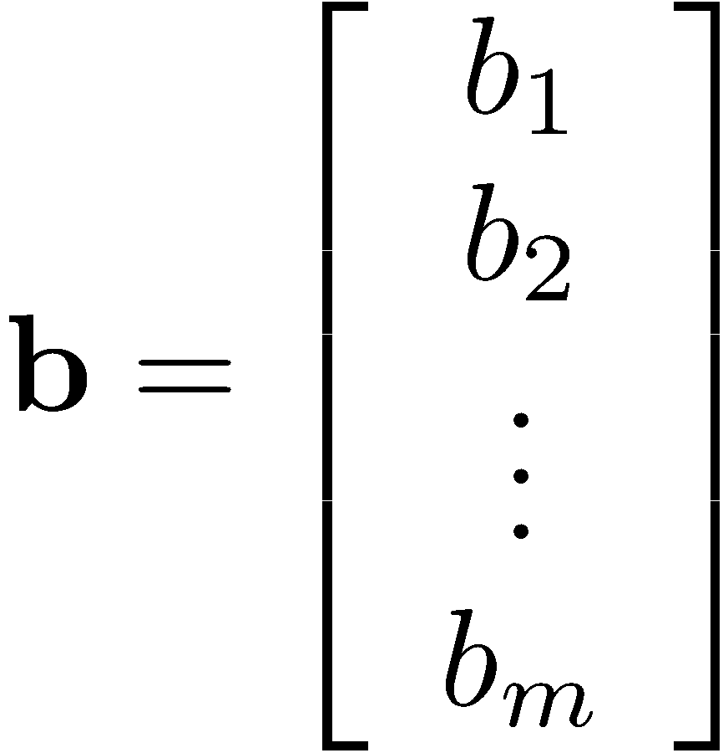
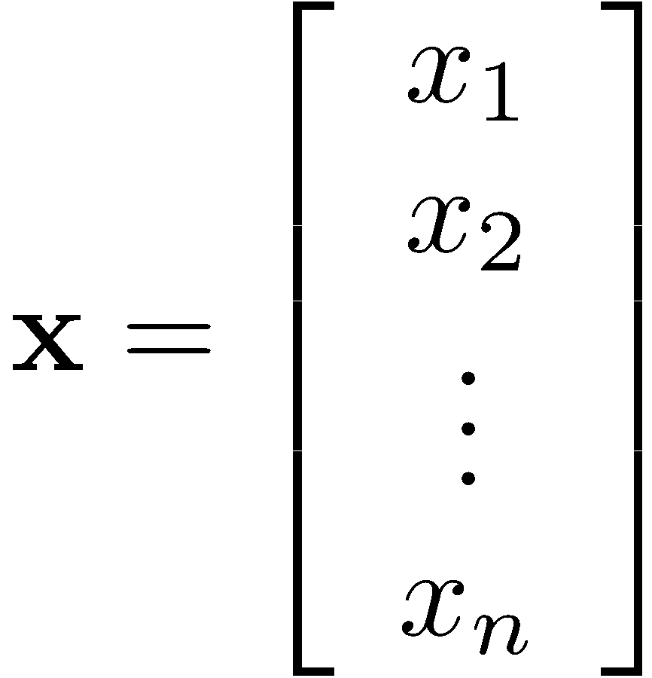
Different representations of an LP
The simplex method is designed to work with this standard format. In this format, all restrictions are equalities and all variables are nonnegative.

Slide 30
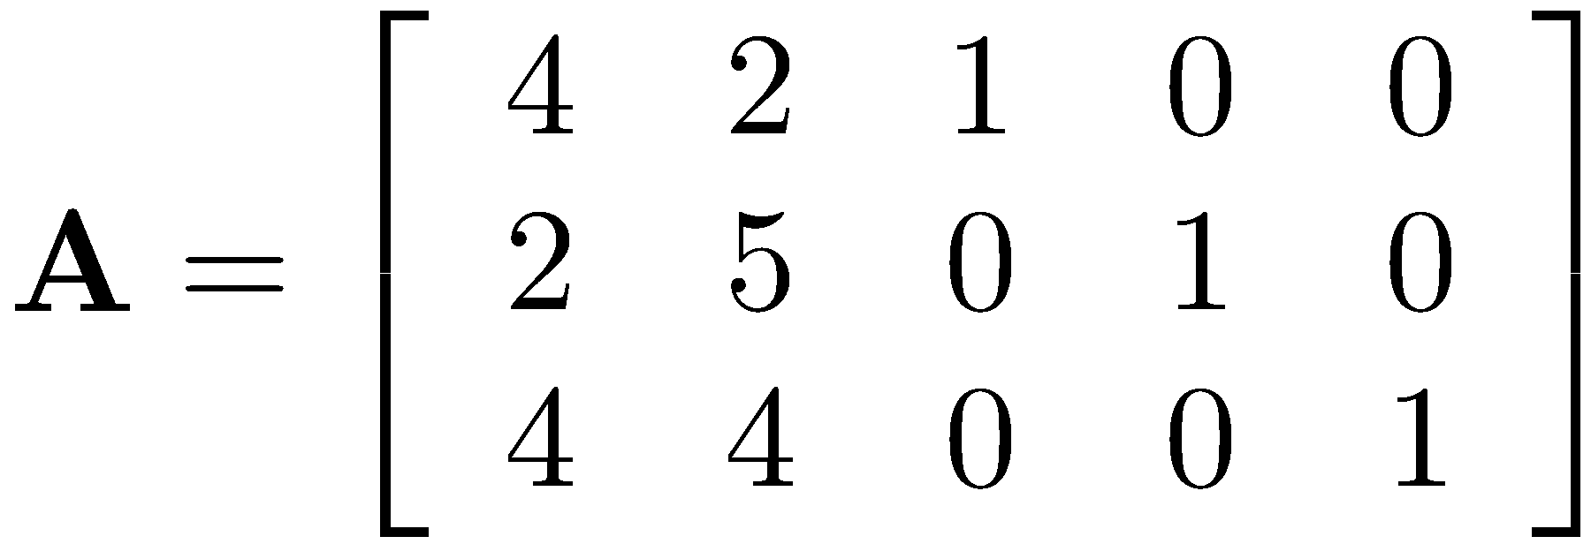
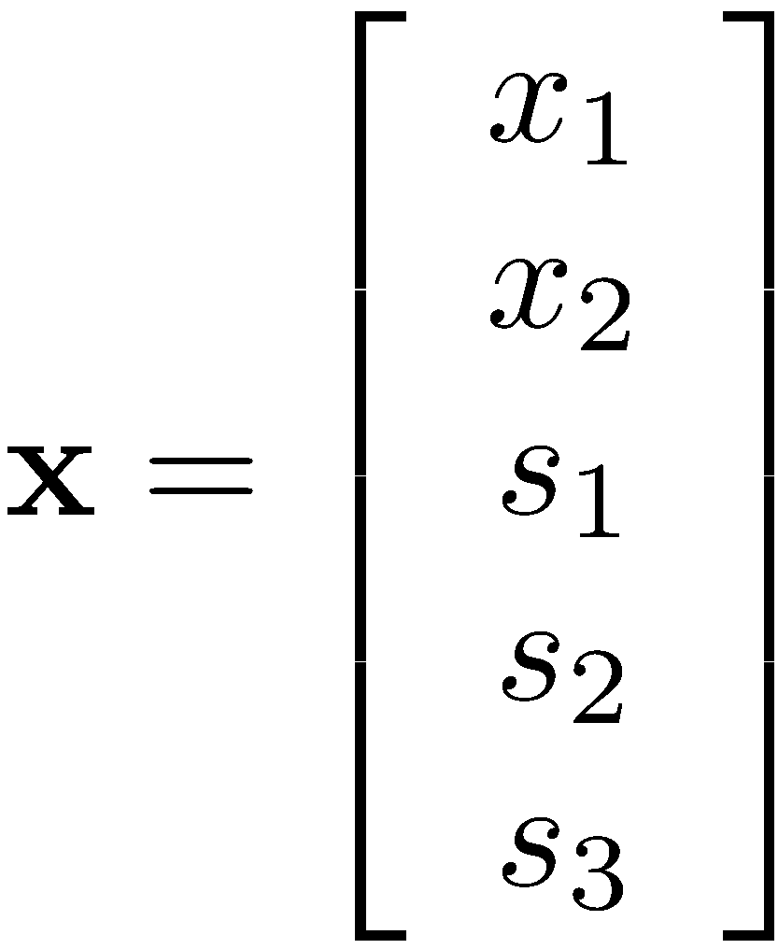
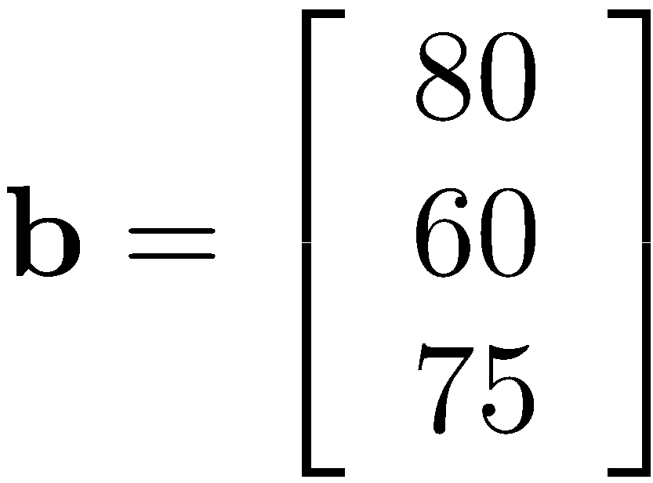
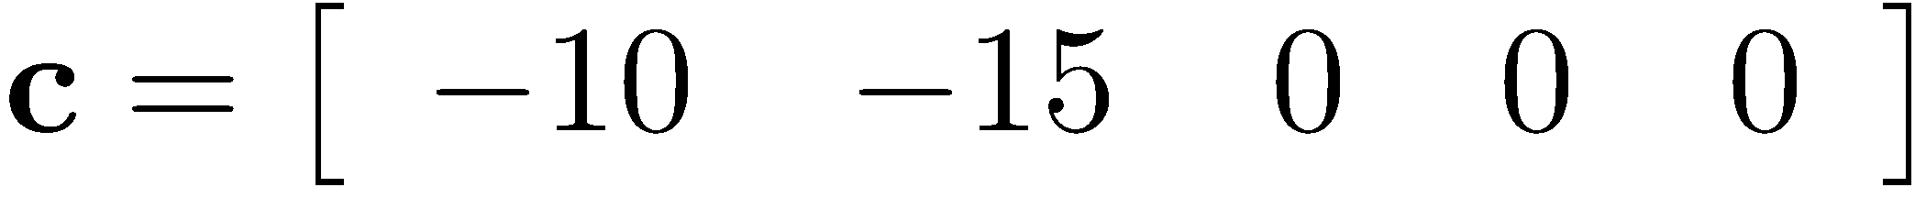
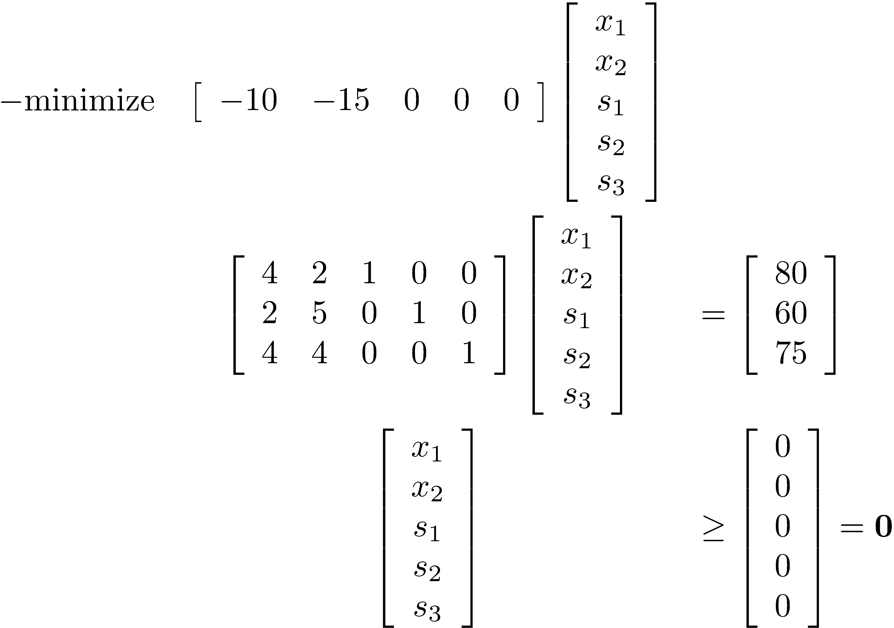
Different representations of an LP

Slide 31
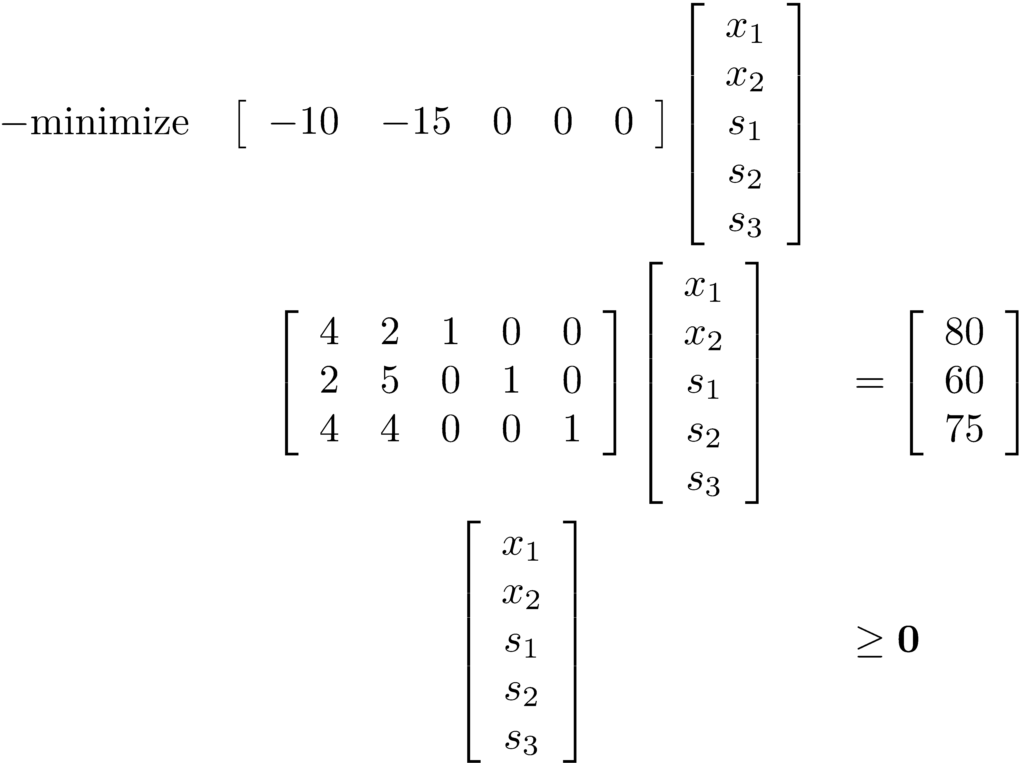




Different representations of an LP
or

Slide 32
Extreme Points (Vertices)
For a system with m equations and n variables, where n>m
  By fixing n-m variables to some value, we can obtain a unique solution for the remaining variables
  By fixing n-m variables to 0, we can obtain a unique solution for the remaining variables that correspond to an extreme point of the feasible region
  By fixing n-m variables to 0, it is possible to obtain infeasible points as well.

Slide 33
Different representations of an LP
or

Slide 34


Example
n = 4 variables, m = 2 equations
Set any n-m = 2 variables to 0 and solve the remaining system.
  x1 = x2 = 0 means x3 = 24 and x4 = 6, objective value 0
  x2 = x3 = 0 means x1 = 4 and x4 = -6, infeasible
  x3 = x4 = 0 means x1 = 3 and x2 = 1.5, objective value 4.5

Slide 35

Key to the simplex method
How do we express b as a linear (not necessarily non-negative) combination of A_{.1}, A_{.2}, …, A_{.n}?
  We need to recall how to solve a system of linear equations from our linear algebra courses.
  Note that we have n variables and m constraints, where n > m ! has infinitely many solutions.
  However, if we can select m linearly independent vectors out of A_{.1}, A_{.2}, …, A_{.n}, then b can be represented uniquely by these vectors.
    Such solutions of are referred to as basic solutions.
    Let the index set of these m linearly independent vectors be B.

Slide 36






Key to the simplex method
40
30
20
10
infeasible
10
20
30

Slide 37
Key to the simplex method
All this is very good news!
  We know that if an LP has an optimal solution, then there exists an extreme point optimal solution.
  It turns out that each basic solution of which is also feasible with respect to the non-negativity constraints corresponds to an extreme point of the feasible region.
  Thus, we have an algebraic method of characterizing the extreme points of the feasible region.

Slide 38



Rudimentary algorithm for LP
Enumerate all basic solutions of and evaluate them one by one.
  There are at most basic solutions.
  Some sets of m columns may be linearly dependent.
  Some basic solutions may be infeasible.
    This was just illustrated.
    Recall that we require all variables to be nonnegative.
  If all basic solutions are infeasible, then we know that the LP instance at hand is infeasible.
  Unfortunately, there is no clear way of detecting unboundedness with this algorithm.
  There may be a huge number of basic solutions. This algorithm is not practical for any problem of meaningful size.

Slide 39
Simplex algorithm
The simplex algorithm traverses the basic feasible solutions of the feasible region in an efficient manner.
Given an initial basic feasible solution,
  The algorithm moves from the current basic feasible solution to a neighboring basic feasible solution.
  The next basic feasible solution does never have a worse objective function value.
  The algorithm includes provisions for detecting unboundedness. For an unbounded problem, it identifies an extreme point and a direction along which the objective function is always improved.
  It solves an auxiliary LP to detect infeasibility.

Slide 40
The geometrical illustration of the simplex method
Locate an initial feasible solution which is a corner point.
Pick a direction in order to move to an adjacent corner point such that the objective is decreased.
Continue until optimality or unboundedness is proven.
At the optimal solution x*, there is no way to improve the objective function value without leaving the feasible region.
  This is a necessary and sufficient condition for x* to be optimal.
x*
If the direction picked makes an acute angle with a normal of a constraint, then we move out of the feasible region.
-c

Slide 41
Simplex algorithm
The simplex algorithm traverses the basic feasible solutions of the feasible region in an efficient manner. Given an initial basic feasible solution,
  The algorithm moves from the current basic feasible solution to a neighboring basic feasible solution.
  The next basic feasible solution does never have a worse objective function value.

Slide 42
Observation on Linear Programming
LP is at the boundary of continuous and combinatorial problems
  The general statement of the problem is continuous, but the search for an optimal solution can be restricted to a finite set of corner points.

Slide 43
The mechanics of the simplex method
Follow my handwritten notes. Let me know if something is illegible.
Try to carry out one more iteration.
40
30
20
10
P₁
P₂
10
20
30

Slide 44
Economic interpretations
We will illustrate the economic concepts that underlie any LP problem using the following product-mix example:
tight

Slide 45
Economic interpretations
Using the information from the LP solution, can you answer the following questions?
  Presumably, the products 3, 4 and 5 are underpriced compared to products 1 and 2. By how much would you have to increase their prices in order for it to be worth to manufacture these products?
    Reduced costs
  What is the value of an extra hour of grinding, drilling or manpower capacity?
    Shadow (dual) prices
Notes:
We are interested in the marginal values of each of these capacities, i.e., in the effect of very small increases or decreases in these capacities on the optimal objective function value.

Slide 46
Economic interpretations
Suppose that a hypothetical generous factory owner is willing to produce our products for us.
The owner will charge us for the grinding, drilling and manpower capacity on an hourly basis, and he does not want to scare us away by overcharging us.
How would the factory owner determine fair prices for his resources so that the total amount of money that we pay him is compatible with the total value of our products?

Slide 47
Economic interpretations
In other words, we are trying to value each of the resources so as to give a minimal overall valuation to the factory compatible with the optimal production plan.
  Suppose that the valuation for each hour of each of the capacities were y₁, y₂, y_{3.}
  What would the objective function be?

Slide 48
Economic interpretations
We wish to obtain values for the y-variables that totally explain the optimal production plan.
It should be possible to attribute the profit contribution of each product to its usage of resources.
Notes:
We need to make sure that the unit profit of each product is totally ‘covered’ by the attributed values of the resources that it uses.
Mention that we must have marginal revenue equal to marginal cost at optimality. Otherwise, we could produce an infinite amount of a product with a net strictly positive marginal benefit and make an unbounded profit.

Slide 49
Primal-Dual LP models
We solve the
Primal LP
So, in this example we have:
Factory owner solves the Dual LP

Slide 50
Primal-Dual solution
Value each hour of grinding capacity at $6.25.
Value each hour of drilling capacity at $0.
Value each hour of manpower capacity at $23.75.

Slide 51
Insights from the dual solution
The total valuation of the factory is the same as the optimal objective function value of the original product mix model.
In other words, the total value of the factory is equal to the value of its optimal output.
Drilling capacity is not totally utilized.
  Therefore, valued at $0/hr.
Resource usage of products 1 and 2:

Slide 52
Insights from the dual solution
Resource usage of products 3, 4 and 5
These products are “too cheap” with respect to the resources that they use.

Slide 53
Insights from the dual solution
Using the valuations from the dual model, we conclude that:
  At most products 1 and 2 should be manufactured.
  Drilling capacity is not binding.
    Word of caution: Although this assertion is true in many cases, a zero dual variable does not always indicate a non-binding constraint.
Notes:
Strictly speaking, the second argument is not correct. A zero dual variable does not necessarily indicate a non-binding constraint. See the discussion on alternate primal optima and dual degeneracy.

Slide 54
Shadow prices
The valuations that we have obtained from the solution of the dual problem are also called shadow prices. Shadow prices denote “opportunity costs.”
  These values are automatically generated by package programs, and their meanings are dependent on the specific application and model.
Shadow prices represent the effect of small changes to the right hand side coefficients, i.e., they are marginal valuations.
  They are valid for specific ranges of the right hand side coefficients.
  These ranges are valid for right-hand-side changes that are considered one at a time.
  Simultaneous changes are more difficult to analyze.
Notes:
Increase in grinding capacity results in an increased opportunity to make more profit.
The shadow price does also denote the cost of the lost opportunity when capacity is reduced.
Shadow prices take into account the different types of uses to which resources may be put.

Slide 55
Reduced costs
In the previous example, the unit profit contributions of products 1 and 2 were covered exactly by the attributed costs of the resources that they use.
For other products (that we do not produce), the attributed costs of the resources exceeded the unit profit contributions of the products.
  This excess amount is called the “reduced cost” of a variable.
  Note that this amount is zero for products 1 and 2.
Technically, a reduced cost corresponds to the infeasibility in the corresponding dual constraint.

Slide 56
Reduced costs
As computed before, the reduced costs for products 3, 4 and 5 are $125, $231.25, and $368.25, respectively.
So, by how much would you have to increase their prices in order for it to be worth to manufacture these products?
The interpretation of reduced costs depends on the specific application and model. They represent opportunity costs of making non-optimal decisions.
Notes:
In a minimization problem, if you force a variable with a positive reduced cost into the model, then the objective function will increase.

Slide 57
Reduced costs
Similar to the shadow prices
  The reduced costs are valid for specific ranges of the objective coefficients.
  These ranges are valid for objective coefficient changes that are considered one at a time.
  Simultaneous changes are more difficult to analyze.

Slide 58
The carpenter’s problem
A linear programming problem formulation
Problem formulation
Maximize z = 40x₁ + 15x₂
subject to 2 x₁ + x₂ ≤ 40
x₁ + 2 x₂ ≤ 50
x₁ ≥ 0, x₂ ≥ 0

Slide 59
Shadow prices and reduced costs
What is sensitivity analysis?
“Sensitivity Report” in the Excel Solver output…

Slide 60
Reduced Cost
Reduced cost of x2 is -5
We have to decrease the objective function coefficient by -5 (increase it by 5) to start producing x2 profitably.
This is what happens graphically

Slide 61


Reduced Cost
Changing objective function coefficient makes x2 profitable

Slide 62
Shadow Price
Shadow price of the labor constraint is 20.
By obtaining 1 unit of labor we gain 20$.
Increasing the resources has some limits
At some point another resource may start to limit us. Hence we also consider allowable increase/decrease in our calculations.

Slide 63

Shadow Price
Increasing the rhs of the labor constraint allows us to increase our profit by 15*20 = 300$.

Slide 64

Shadow Price
When we exceed the allowable increase, the raw material constraints start to limit us. At this point bringing in more labor will not benefit us any more.

Slide 65
Wrap-up
Changing the objective function coefficient by more than the reduced cost allow us to use the corresponding variable.
  Optimal solution changes
Changing the rhs of a binding constraint in the allowable range allows us to improve our solution.
  Optimal solution changes but corresponds to the extreme point at the intersection of same constraints at the original solution.

Slide 66
Carpenter’s Problem with Integer Variables

Slide 67
Solving IPs (Branch&bound)

Slide 68

Solving IPs
Current best= -infinity

Slide 69


Solving IPs
Current best= -infinity
We create two problems
x<=3
x>=4

Slide 70

Solving IPs
Current best= -infinity

Slide 71

Solving IPs
Current best= 4
We solve the blue problem to optimality

Slide 72

Solving IPs
Current best= 4

Slide 73

Solving IPs
Current best= 4
We create two more problems

Slide 74

Solving IPs
Current best= 4 => 6

Slide 75


Solving IPs
Current best= 6
The blue problem is solved to optimality.
Do we need to solve the yellow problem?

Slide 76
Solving IP’s: Branch & Bound
Solving a series of LP relaxations of the original problem where integer/binary variables are not so restricted.
Systematic enumeration of LP-feasible solutions with additional integrality constraints or enforcing bounds.
Relies on the fact that a relaxed solution provides better than an (integer) restricted solution, and eliminates non-promising LP-feasible solutions.
Use a tree structure with
  most relaxed solution sitting at the root
  branching out with integrality constraints or enforcing bounds on the variables

Slide 77

Solving IP’s: Branch & Bound
Solve the following 0-1 programming problem
Start by solving the LP-relaxation

Slide 78

Solving IP’s: Branch & Bound

